Slide 1
Heterogeneous Computing using OpenCL
Distributed and Parallel Technology
Yun Wu

Slide 2
Course Overview
Red or Blue
Version history, OpenCL in nutshell, OpenCL applications, objectives
Approaches the Facts
GPU architecture brief and massive parallelism
Parallel Processing: SMP, SIMD, SPMD, SIMT
OpenCL programming model (platform, memory, execution, …), compiling and execution
Doges the Bullets
Data types, API functions, kernel programming
Events, profiling, synchronization
Flying like Superhero
OpenCL optimization: matrix multiplication case study

Slide 3




Red or Blue

Slide 4
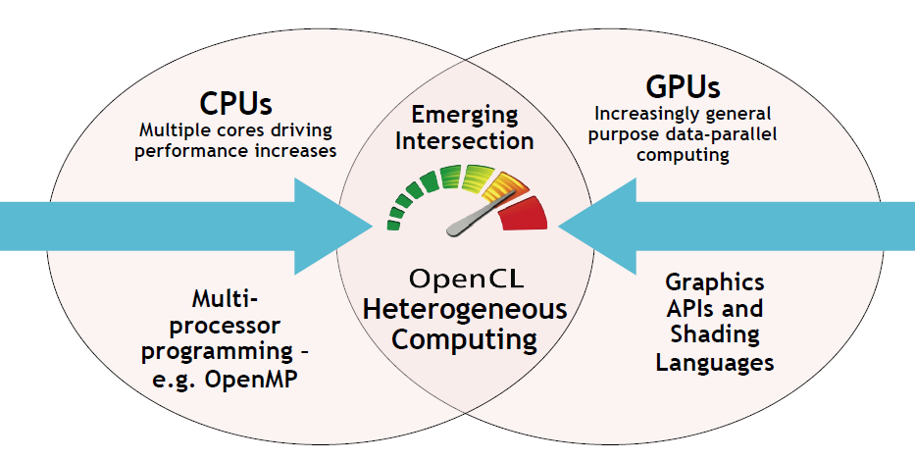
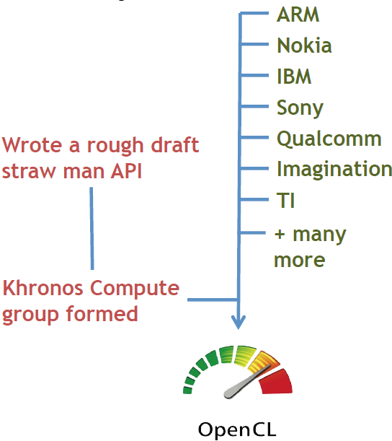
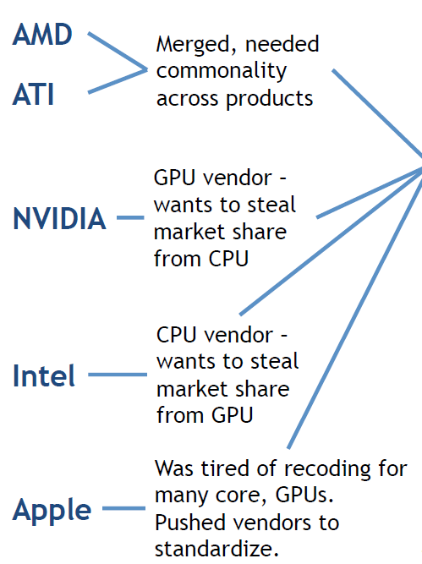
Version History
Early
OpenCL 1.0 released with OpenCL 1.0 released with Mac OS X Snow Leopard on August 28, 2009.
OpenCL 1.1 was ratified by the Khronos Group on June 14, 2010.
OpenCL 1.2 released on November 15, 2011
Recent
OpenCL 2.0 released on November 18, 2013
OpenCL 2.1 released on March 3, 2015
OpenCL 2.2 released on May 16, 2017
OpenCL 3.0 released on September 30, 2020
Current – Still Active
OpenCL 3.0.x continues updating up to 3.0.10 on November 19, 2021

Slide 5
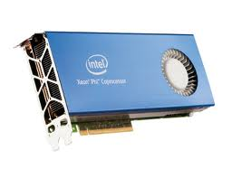
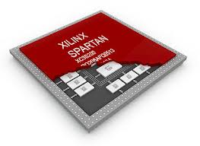
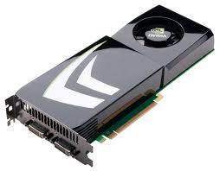
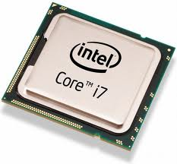
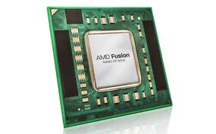
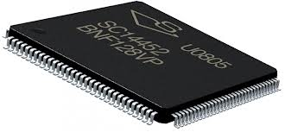
OpenCL in Nutshell
OpenCL (Open Computing Language) is a framework for writing programs that execute across heterogeneous platforms:
central processing units (CPUs)
graphics processing units (GPUs)
digital signal processors (DSPs)
field-programmable gate arrays (FPGAs)
and other processors or hardware accelerators.
It is a C-like “language” for writing programs.
functions executed in parallel on an OpenCL device are called "kernels"
standard application programming interface (API) library
launch kernels execution and manage device memory between host and devices
portable execution due to compiled at run-time
Highly relying on device targeted compiler
Highly relying on hardware driver

Slide 6
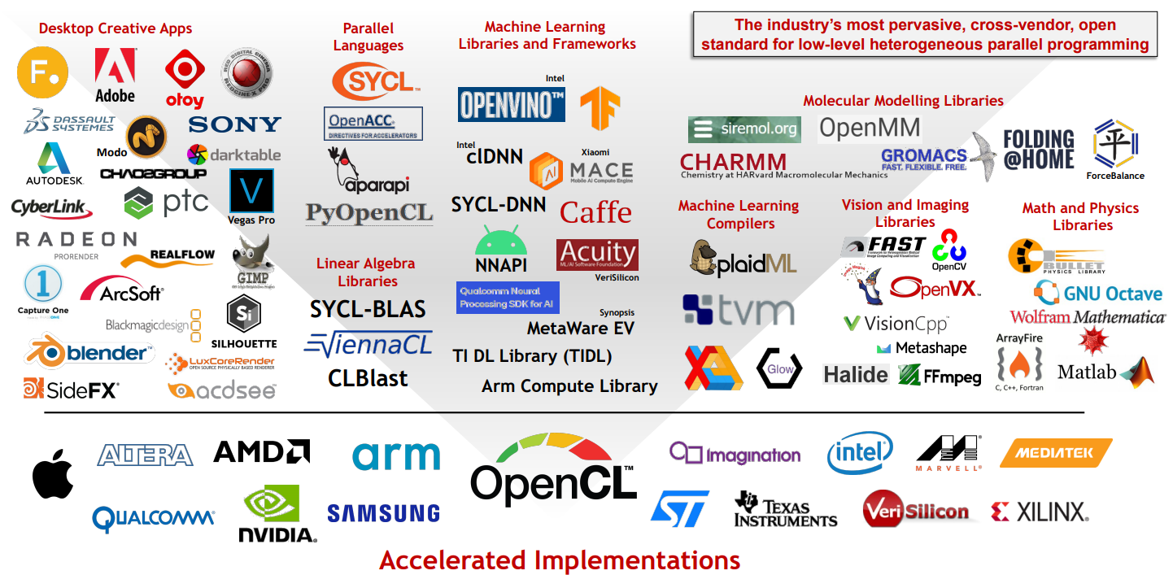
OpenCL Applications
OpenCL is widely deployed and used throughout the industry
https://en.wikipedia.org/wiki/List_of_OpenCL_applications

Slide 7
Course Objectives
Introduction to the OpenCL
Cover some of the basic APIs
OpenCL program in C, mainly targeting OpenCL 1.2 (the most widely adopted version)
Focus on OpenCL programming for General Purpose (GP) GPU
After completion of this course, you should be ready to accelerate your applications on GPGPU using OpenCL

Slide 8
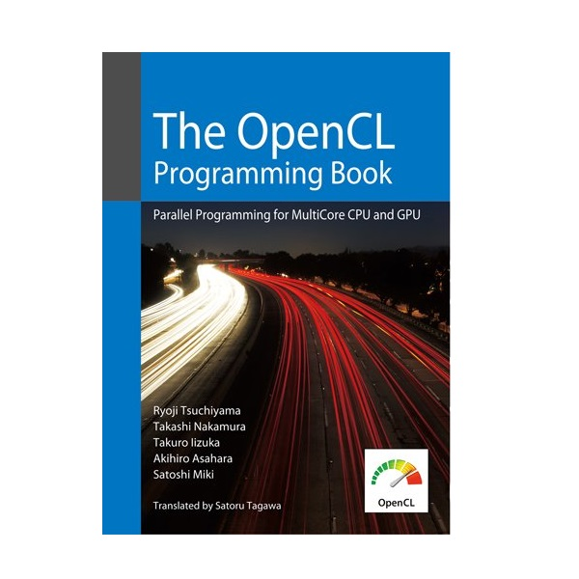



Supplementary Materials
See online tutorial at www.khronos.org
Intel OpenCL tutorial at www.intel.com
“The OpenCL Programming Book” online - https://us.fixstars.com/products/opencl/book/#html - Ryoji Tsuchiyama
“OpenCL Programming Guide” book
Aaftab Munshi
“Heterogeneous Computing with OpenCL” book
Benedict Gaster, etc.
“Heterogeneous Computing with OpenCL 2.0” book
David Kaeli, etc.

Slide 9
Hello World
… …
clGetPlatformIDs(1, &platform_id, &ret_num_platforms);
clGetDeviceIDs(platform_id, CL_DEVICE_TYPE_DEFAULT, 1, &device_id, &ret_num_devices);
context = clCreateContext(NULL, 1, &device_id, NULL, NULL, &ret);
command_queue = clCreateCommandQueue(context, device_id, 0, &ret);
memobj = clCreateBuffer(context, CL_MEM_READ_WRITE,MEM_SIZE * sizeof(char), NULL, &ret);
program = clCreateProgramWithSource(context, 1, (const char **)&source_str, (const size_t *)&source_size, &ret);
clBuildProgram(program, 1, &device_id, NULL, NULL, NULL);
kernel = clCreateKernel(program, "hello", &ret);
clSetKernelArg(kernel, 0, sizeof(cl_mem), (void *)&memobj);
clEnqueueTask(command_queue, kernel, 0, NULL,NULL);
ret = clEnqueueReadBuffer(command_queue, memobj, CL_TRUE, 0, MEM_SIZE * sizeof(char),string, 0, NULL, NULL);
… …
__kernel void hello(__global char* string)
{
string[0] = 'H';
string[1] = 'e';
string[2] = 'l';
string[3] = 'l';
string[4] = 'o';
string[5] = ',';
string[6] = ' ';
string[7] = 'W';
string[8] = 'o';
string[9] = 'r';
string[10] = 'l';
string[11] = 'd';
string[12] = '!';
string[13] = '\0';
}

Slide 10

Approaches the Facts

Slide 11
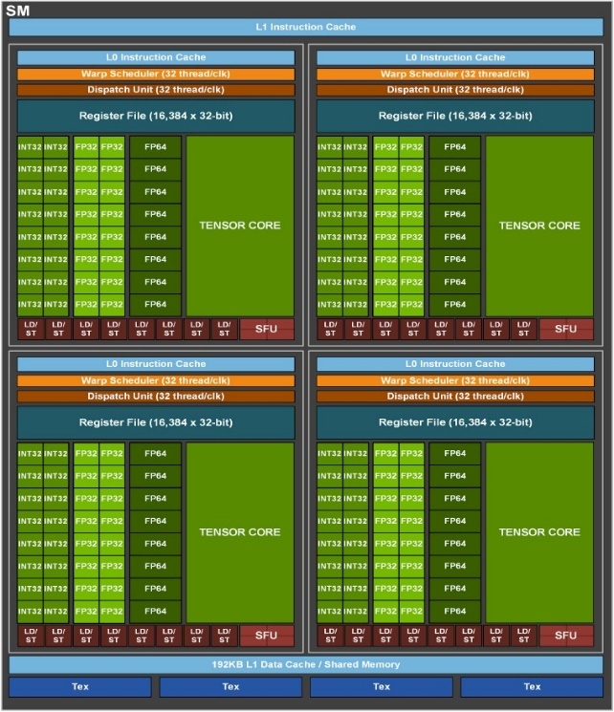
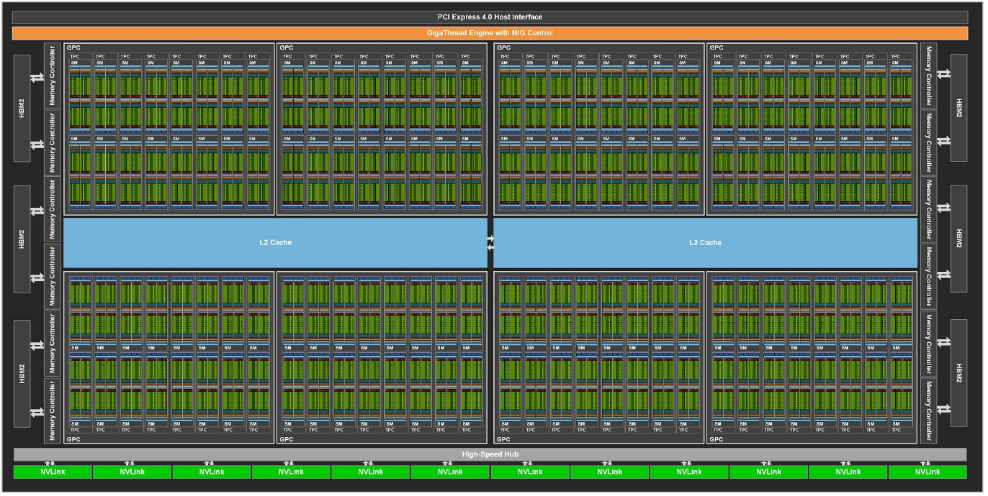
Nvidia GA100 Ampere Architecture
128 Streaming Multiprocessor (SM)
Each SM support INT16, INT32, INT64, FP16, FP32, FP64 operations
64 FP32 CUDA Cores/SM
8192 FP32 CUDA Cores in total
New third-generation Tensor Cores that each perform 256 FP16/FP32 FMA operations per clock.

Slide 12
Massive Parallelism on GPU
Single-threaded (CPU)
= loop iteration
// there are N elements
for(i = 0; i < N; i++)
C[i] = A[i] + B[i]
Time
T0
0
1
2
3
4
5
6
7
8
9
10
15
Multi-threaded (CPU)
// tid is the thread id
for(i = tid; i < steps; i+=threads)
C[i] = A[i] + B[i]
T0
0
1
2
3
T1
4
5
6
7
T2
8
9
10
11
T3
12
13
14
15
Massively Multi-threaded (GPU)
T0
0
// tid is the thread id
C[tid] = A[tid] + B[tid]
T1
1
T2
2
T3
3
T15
15

Slide 13
Recap Parallel Processing Concepts
SMP - Symmetric Multiprocessing
SIMD - Single Instruction Multiple Data
SPMD - Single Program Multiple Data
SIMT - Single Instruction, Multiple Threads

Slide 14
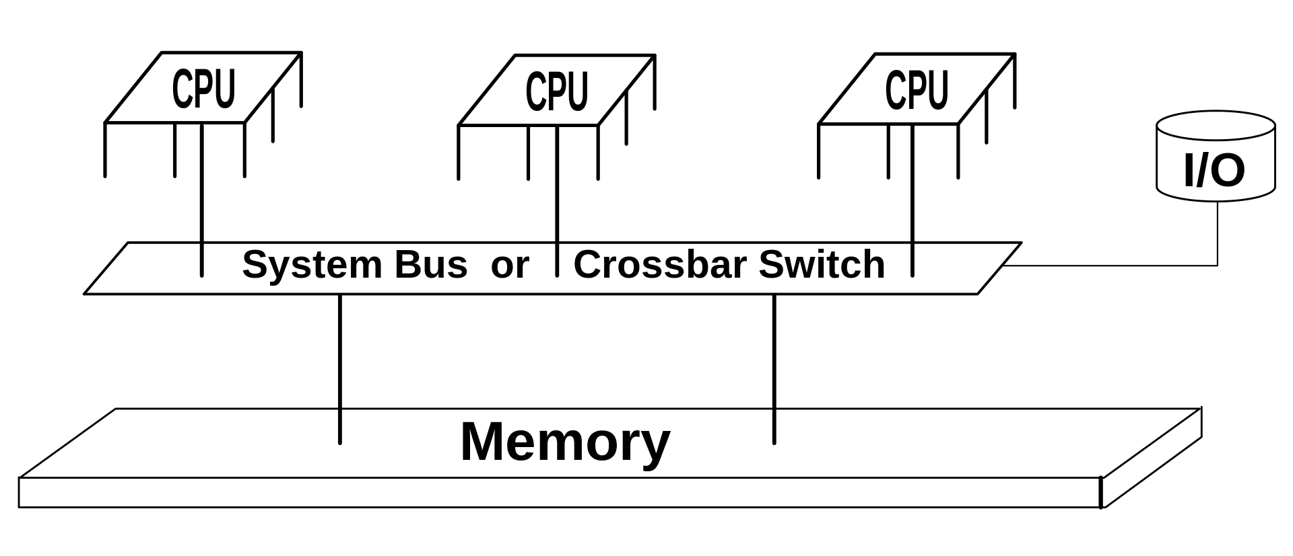
Symmetric Multiprocessing
Symmetric Multiprocessing (SMP)
Identical: All the processors are treated equally i.e. all are identical.
Communication: Shared memory is the mode of communication among processors.
Complexity: Are complex in design, as all units share same memory and data bus.
Expensive: They are costlier in nature.
Unlike asymmetric where a task is done only by Master processor, here tasks of the operating system are handled individually by processors.

Slide 15
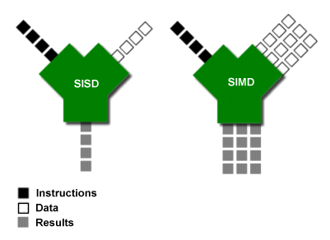
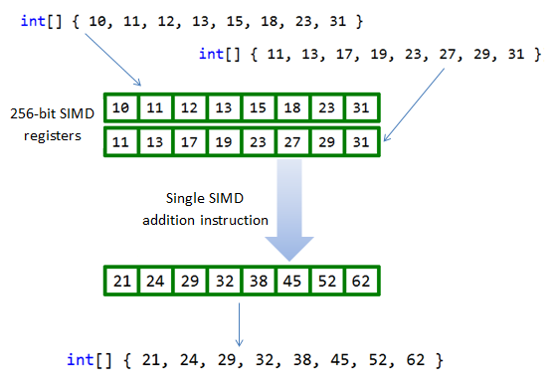
SIMD or SPMD
SIMD - Single Instruction Multiple Data
Normally refers to a computer architecture that a processor can emit a single instruction to several processing elements
Each processing element takes data input and output data in parallel
SPMD - Single Program Multiple Data
Normally refers to a parallel programming methods for single SIMD processor
The same program runs on multiple processor or node with different input in order to obtain results faster.

Slide 16
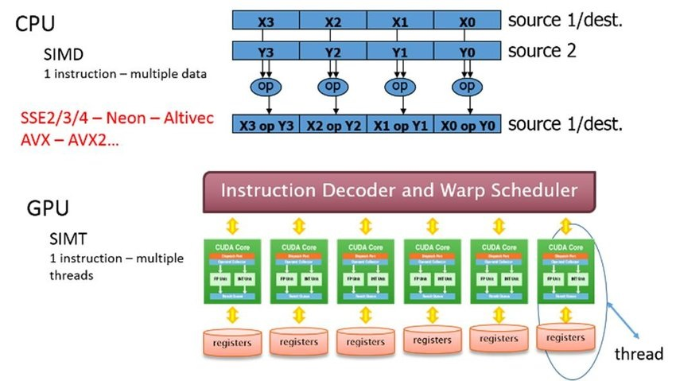
SIMT
SIMT - Single Instruction, Multiple Threads
It’s the thread equivalent of SIMD
Multiple threads perform the same instruction on different data sets.
It reduces the latency that comes with instruction prefetching (Very important for GPGPU).
Every time the GPU needs to execute a particular instruction, the data and instructions are fetched from the memory and then decoded and executed. In this case, all the data sets (up to a certain limit) that need the same instruction for execution are prefetched and executed simultaneously using the various threads available to the processor.

Slide 17
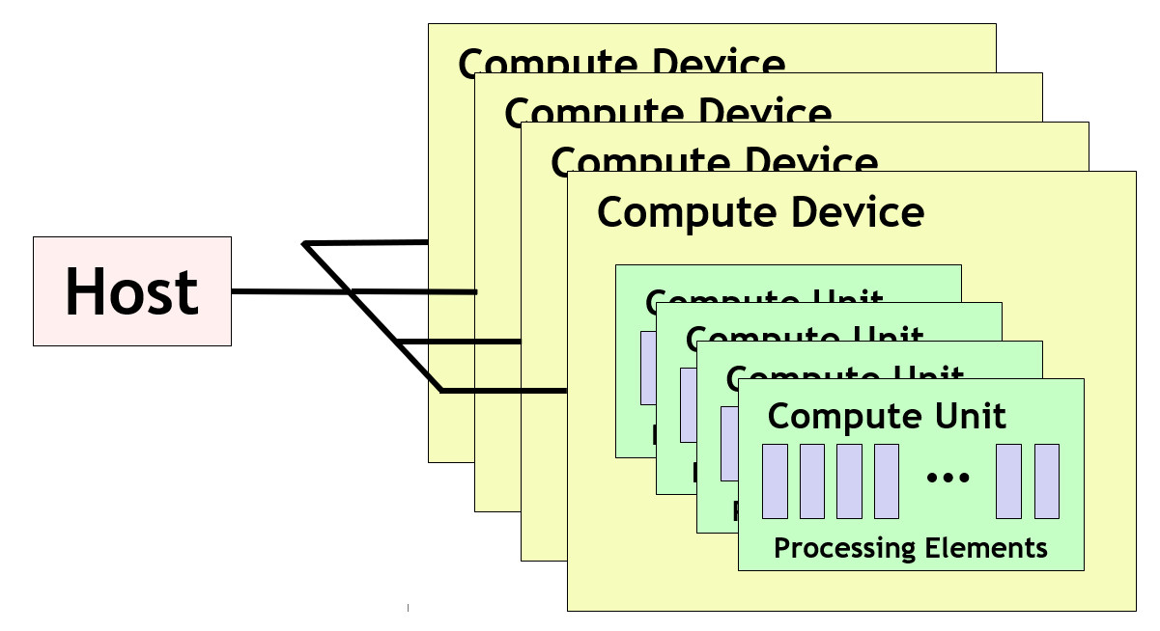
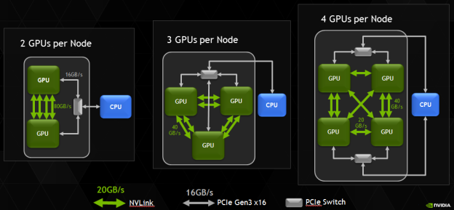
OpenCL Platform Model
It is how OpenCL understands the compute resources in a system to be topologically connected.
A host is connected to one or more OpenCL compute devices.
Each compute device is collection of one or more compute units where each compute unit is composed of one or more processing elements.
Processing elements execute code with SIMT.

Slide 18
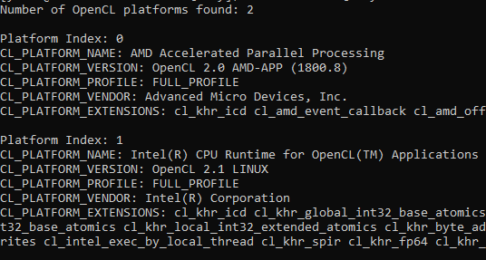
Query Platform Information
cl_int numOfPlatforms;
clGetPlatformIDs(0, NULL, &numOfPlatforms);
cl_platform_id*) platforms = (cl_platform_id*) alloca(sizeof(cl_platform_id) numOfPlatforms);
clGetPlatformIDs(numOfPlatforms, platforms, NULL);
clGetPlatformInfo( id, param_name, 0, NULL,
&paramSize );
char* moreInfo = (char*)alloca( sizeof(char) * paramSize);
clGetPlatformInfo( id, param_name, paramSize,
moreInfo, NULL );
param_name:
CL_PLATFORM_NAME
CL_PLATFORM_VERSION
CL_PLATFORM_PROFILE
CL_PLATFORM_VENDOR
CL_PLATFORM_EXTENSIONS

Slide 19
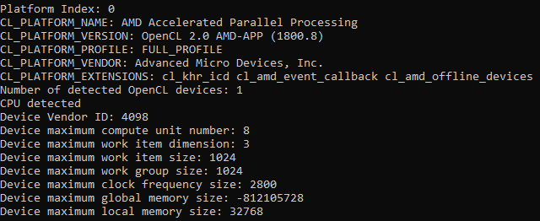
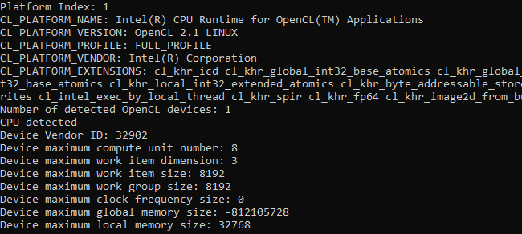
Query Devices on Platform
cl_uint numOfDevices = 0;
clGetDeviceIDs(platform_id, CL_DEVICE_TYPE_ALL, 0, NULL, &numOfDevices);
cl_uint* devInfo = (cl_uint*) alloca(sizeof(cl_uint) * paramSize);
clGetDeviceInfo( device_id, param_name, paramSize, devInfo, NULL );
param_name:
CL_DEVICE_TYPE
CL_DEVICE_VENDOR_ID
CL_DEVICE_MAX_COMPUTE_UNITS
CL_DEVICE_MAX_WORK_ITEM_DIMENSIONS
CL_DEVICE_MAX_WORK_ITEM_SIZES
CL_DEVICE_MAX_WORK_GROUP_SIZE
CL_DEVICE_MAX_CLOCK_FREQUENCY
CL_DEVICE_GLOBAL_MEM_SIZE
CL_DEVICE_LOCAL_MEM_SIZE

Slide 20
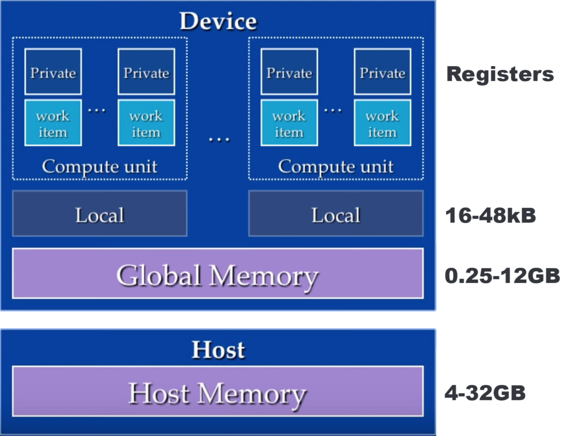
OpenCL Memory Model
OpenCL memory management is explicit. None of the memories are automatically synchronized and so the application explicitly moves data between memory types as needed:
Host memory - available to the host CPU, refer to the main DDR memory.
Global/Constant memory - available to all compute units in a compute device, refer to the GPU GDDR memory.
Slow, visible by all, read or write. It is where all your data will end, so some accesses to it are always necessary.
Constant memory: A small portion of cached global memory visible by all workers. Use it if you can, read only.
Local memory - available to all the processing elements in a compute unit.
Only visible inside local workers, and is limited in size, however, is very fast.
Private memory - available to a single processing element, refer to the register file.
Memory that is only visible to a worker. All non defined values are private by default.

Slide 21
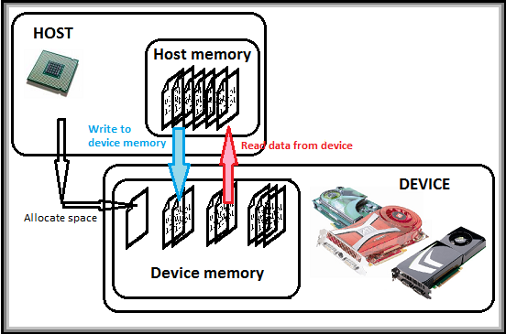
Vector Addition
int *A = (int*)malloc(sizeof(int)*LIST_SIZE);
int *B = (int*)malloc(sizeof(int)*LIST_SIZE);
int *C = (int*)malloc(sizeof(int)*LIST_SIZE);
… … (get platform, devices, and create the OpenCL context)
cl_mem a_mem_obj = clCreateBuffer(context, CL_MEM_READ_ONLY, LIST_SIZE * sizeof(int), NULL, &ret);
cl_mem b_mem_obj = clCreateBuffer(context, CL_MEM_READ_ONLY, LIST_SIZE * sizeof(int), NULL, &ret);
cl_mem c_mem_obj = clCreateBuffer(context, CL_MEM_WRITE_ONLY, LIST_SIZE * sizeof(int), NULL, &ret);
clEnqueueWriteBuffer(command_queue, a_mem_obj, CL_TRUE, 0, LIST_SIZE * sizeof(int), A, 0, NULL, NULL);
clEnqueueWriteBuffer(command_queue, b_mem_obj, CL_TRUE, 0, LIST_SIZE * sizeof(int), B, 0, NULL, NULL);
… … (create kernel, set the argument, and execute the kernel)
clEnqueueReadBuffer(command_queue, c_mem_obj, CL_TRUE, 0, LIST_SIZE * sizeof(int), C, 0, NULL, NULL);
… …

Slide 22
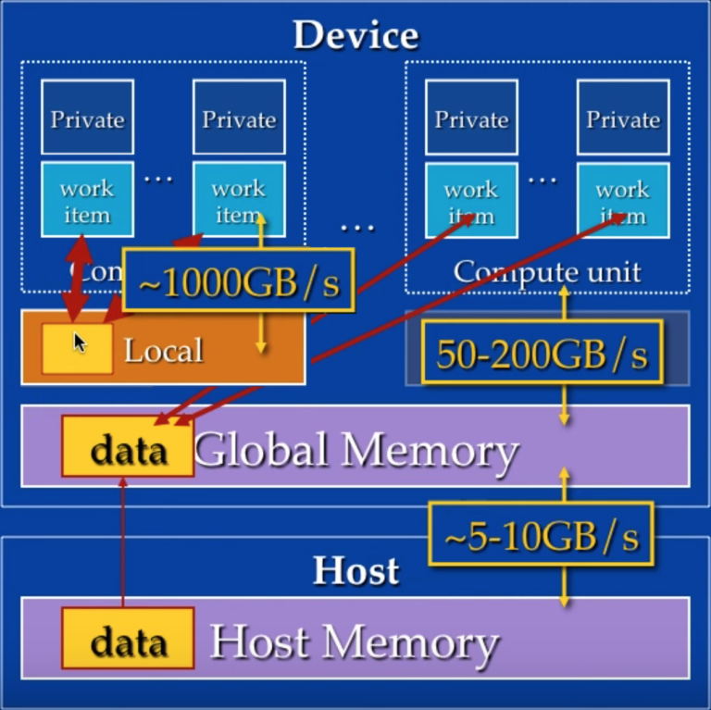
Vector Addition
__kernel void vector_add(__global int *A, __global int *B, __global int *C) {
// Get the index of the current element
__private int i = get_global_id(0);
// Do the operation
__local a = A[i];
__local b = B[i];
__local c = a + b;
C[i] = c;
}

Slide 23
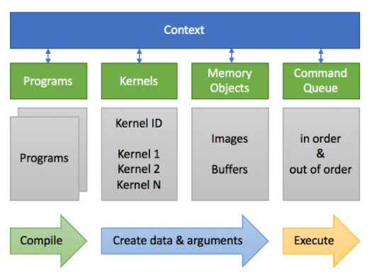
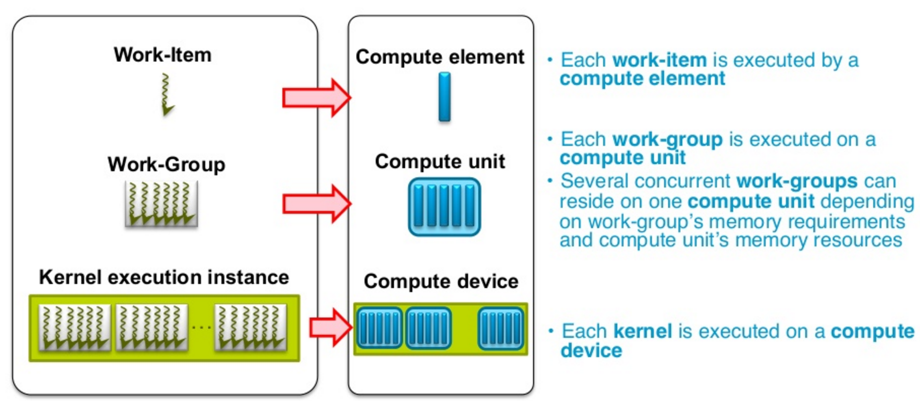
OpenCL Execution Model
There are two distinct executing program:
host program that executes on the host. It is an outer control logic that performs the configuration for a GPU-based application.
kernels program that execute on one or more OpenCL devices. It is the essential accelerating function that is allowed to be compiled for execution on any OpenCL device.
The host program:
Discovers OpenCL platform and devices and create relative OpenCL context
Creates OpenCL memory buffer interface between host and devices
Compiles the kernel source and create kernel with argument mapping to OpenCL memory buffer
Manages the data streaming between host and devices
Manages the OpenCL objects
The kernel program:
Specify the function operations to be accelerated
Maps the memory location of variables
Execute the accelerating function according to the configured dimension and workgroup size

Slide 24
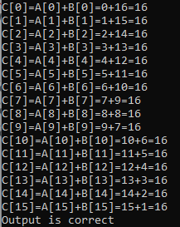
Vector Addition – Host Program
… …
cl_program program = clCreateProgramWithSource(
context, 1, (const char**)&programSource, NULL, &status);
clBuildProgram( program, numDevices, devices,
NULL, NULL, NULL);
cl_kernel kernel = clCreateKernel(program, " vector_add ", &status);
clSetKernelArg(kernel, 0, sizeof(cl_mem), &bufferA);
clSetKernelArg(kernel, 1, sizeof(cl_mem), &bufferB);
clSetKernelArg(kernel, 2, sizeof(cl_mem), &bufferC);
… ...
cl_int wgdim = 1;
size_t globalWorkSize[wgdim];
globalWorkSize[0] = 16;
clEnqueueNDRangeKernel(cmdQueue, kernel,
wgdim, NULL, globalWorkSize, NULL,
0, NULL, NULL);
… …

Slide 25
Vector Addition – Kernel Program
Memory location
__kernel void vector_add(__global int *A, __global int *B, __global int *C) {
// Get the index of the current element
__private int i = get_global_id(0);
// Do the operation
__local a = A[i];
__local b = B[i];
__local c = a + b;
C[i] = c;
}
Work item index
Parallel function

Slide 26

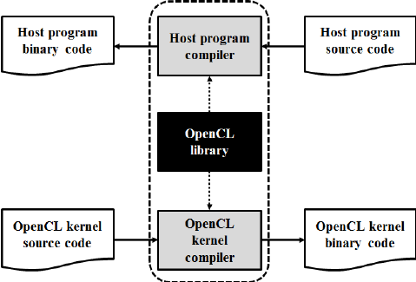



Compilers
Most compilers support OpenCL with “–lOpenCL” compiler flag
Intel (ioc)
Nvidia (nvcc )
GNU (gcc, g++)
LLVM with Clang&Clang++

Slide 27
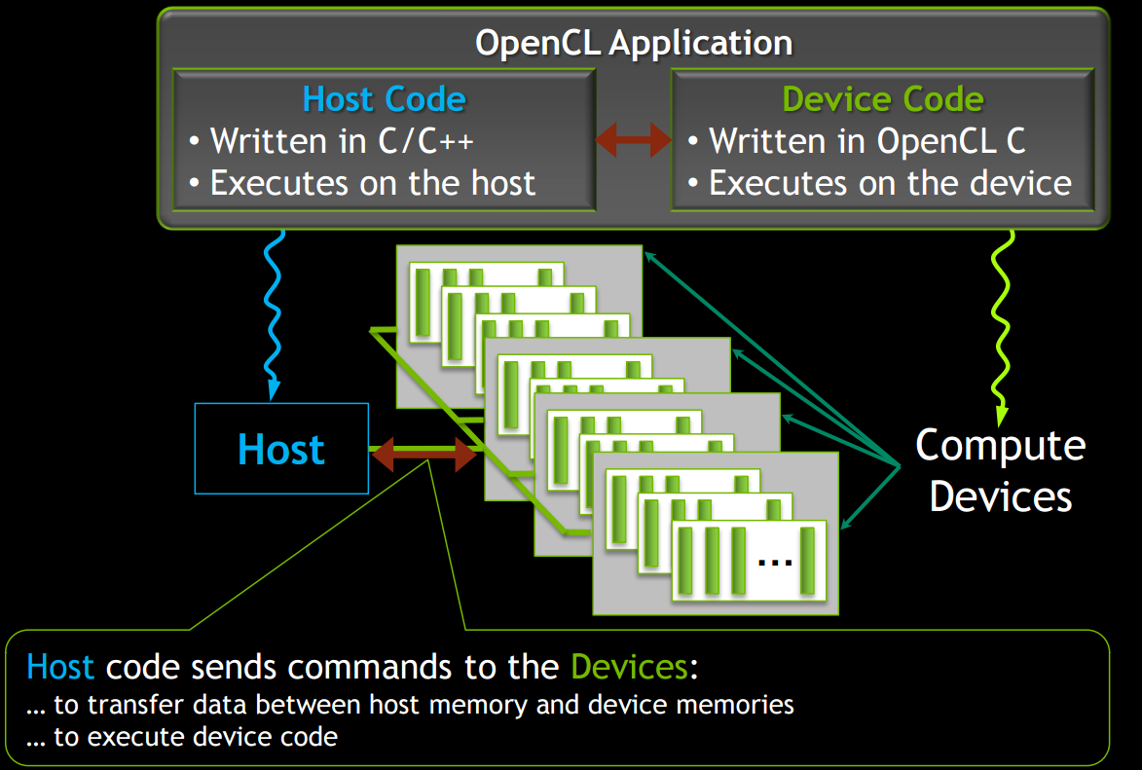
Execution
Nvidia CUDA Toolkit
Windows OS
Linux
macOS
Intel OpenCL SDK
Windows OS
Linux
AMD ROCm
Linux
Microsoft Visual Studio
Windows OS
Apple Xcode
macOS

Slide 28

Doges the Bullets

Slide 29
OpenCL Data Types
Scalar data types: used to create kernels that are executed on OpenCL device(s).
bool, char, cl_char, unsigned char, uchar, cl_uchar, short, cl_short, unsigned short, ushort, cl_ushort, int, cl_int, unsigned int, uint, cl_uint, long, cl_long, unsigned long, ulong, cl_ulong, float, size_t, ptrdiff_t, intptr_t, uintptr_t, void, double, and half floating-point types.
Vector data types: scalar data type with a literal value n that defines the number of elements in the vector. Supported values of n are 2, 3, 4, 8, and 16 for all vector data types.
charn, ucharn, shortn, ushortn, intn, uintn, longn, ulongn, floatn, doublen, and optional halfn types.
Abstract data types: built-in data types for OpenCL objects.
cl_platform_id, cl_device_id, cl_context, cl_command_queue, cl_mem, cl_program, cl_kernel, cl_event, and cl_sampler.

Slide 30
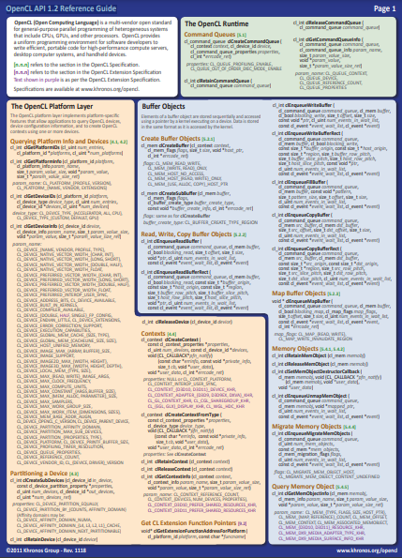
API Functions
OpenCL Platform Layer
cl_int clGetPlatformIDs(…)
cl_int clGetDeviceIDs(…)
cl_context clCreateContext (…)
cl_int clReleaseDevice (…)
cl_int clReleaseContext (…)
The OpenCL Runtime
cl_command_queue clCreateCommandQueue (…)
cl_int clReleaseCommandQueue (…)
Buffer Objects
cl_mem clCreateBuffer (…)
cl_int clEnqueueReadBuffer (…)
cl_int clEnqueueWriteBuffer (…)
clReleaseMemObject(…)
Program Objects
cl_program clCreateProgramWithSource (...)
cl_program clCreateProgramWithBinary (...)
cl_int clBuildProgram(...)
Kernel and Event Objects
cl_kernel clCreateKernel (...)
cl_int clSetKernelArg (...)
cl_int clEnqueueNDRangeKernel (...)
OpenCL 1.2 Reference Guide

Slide 31
OpenCL Platform
A platform is a specific OpenCL implementation, for instance AMD APP, NVIDIA or Intel OpenCL.
cl_int clGetPlatformIDs (
cl_uint num_entries, // number of platform can be added cl_platform_id *platforms, // a list of found platforms
cl_uint *num_platforms) // number of platforms available
num_entries can be set to NULL to query num_platforms
num_platforms can be set to NULL once num_entries is determined
#1
#2
#3

Slide 32
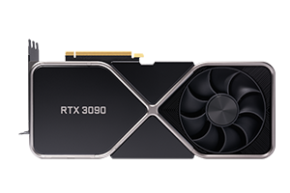
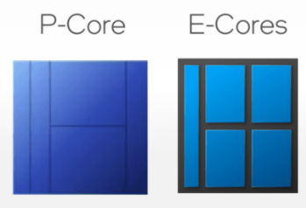

OpenCL Device
The devices are the actual processors (CPU, GPU etc.) that perform computational operations.
cl_int clGetDeviceIDs(
cl_platform_id platform, // platform from clGetPlatformIDs
cl_device_type device_type, // the type of OpenCL device
cl_uint num_entries, // number of device can be added
cl_device_id* devices, // list of OpenCL devices
cl_uint* num_devices); // number of available OpenCL devices
device_type:
CL_​DEVICE_​TYPE_​CPU
CL_​DEVICE_​TYPE_​GPU
CL_​DEVICE_​TYPE_​ACCELERATOR
CL_​DEVICE_​TYPE_​CUSTOM
CL_​DEVICE_​TYPE_​DEFAULT
CL_​DEVICE_​TYPE_​ALL
num_entries can be NULL for querying num_devices
num_devices can be NULL once num_entries is determined
#1 RTX 3090
#2 RTX 3090
#1 Gen 12th CPU
#2 Xe GPU

Slide 33
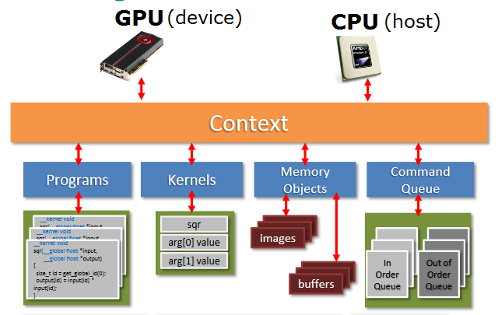
OpenCL Context
The runtime interface between the host (CPU) and device (GPU or CPU) which manages all the OpenCL resources (programs, kernels, command queue, buffers).
cl_context clCreateContext(
const cl_context_properties* properties, // context property names and corresponding values
cl_uint num_devices, // number of devices in context
const cl_device_id* devices, // devices entries in context
void (CL_CALLBACK* pfn_notify)(const char* errinfo, const void* private_info, size_t cb, void* user_data), // callback function
void* user_data, // the user_data field of callback function
cl_int* errcode_ret); // error codex
All the OpenCL objects are created based on valid context.
The devices in context can be from either the same platform or different ones.
It receives and distributes kernels and transfers data.

Slide 34
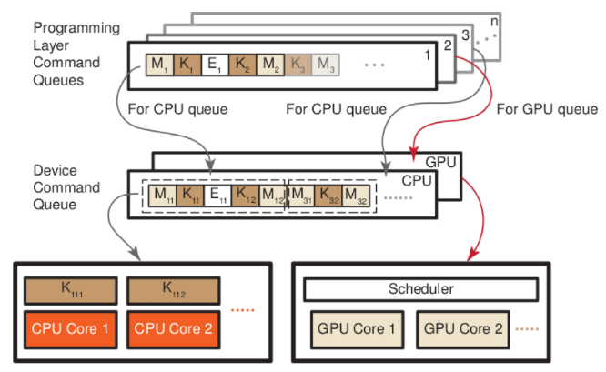
OpenCL Command Queue
Command queue is a container of computation and communication operations related to kernels execution on a specific device.
cl_command_queue clCreateCommandQueue(
cl_context context, // a valid context
cl_device_id device, // a valid device
cl_command_queue_properties properties, // list of properties
cl_int* errcode_ret); // error codex
properties:
CL_​QUEUE_​OUT_​OF_​ORDER_​EXEC_​MODE_​ENABLE
CL_​QUEUE_​PROFILING_​ENABLE
The execution can be either in-order or out-of-order

Slide 35
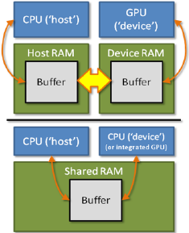
OpenCL Buffer
Data used by OpenCL devices is stored in a “buffer” on the device.
An OpenCL buffer object is created using the following function:
cl_mem bufferobj = clCreateBuffer (
cl_context context, //Context name
cl_mem_flags flags, //Memory flags
size_t size, //Memory size allocated in buffer
void *host_ptr, //Host data
cl_int *errcode) //Returned error code
Data can implicitly be copied to the device using a host pointer parameter
In this case copy to device is invoked when kernel is enqueued

Slide 36
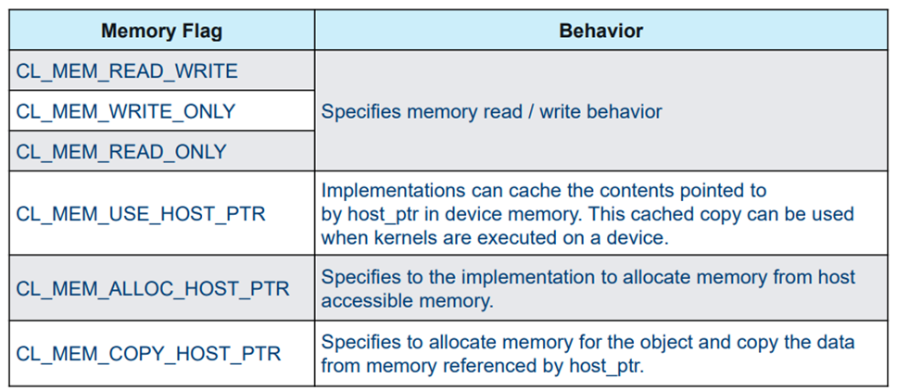
OpenCL Buffer
Memory flag field in clCreateBuffer() allows us to define characteristics of the buffer object:

Slide 37
Copy Buffer to Devices
clEnqueueWriteBuffer() is used to write a buffer object to device memory (from the host)
Provides more control over copy process than using host pointer functionality of clCreateBuffer()
Allows waiting for events and blocking
cl_int clEnqueueWriteBuffer (
cl_command_queue queue, //Command queue to device
cl_mem buffer, //OpenCL Buffer Object
cl_bool blocking_read, //Blocking/Non-Blocking Flag
size_t offset, //Offset into buffer to write to
size_t cb, //Size of data
void *ptr, //Host pointer
cl_uint num_in_wait_list, //Number of events in wait list
const cl_event * event_wait_list, //Array of events to wait for
cl_event *event) //Event handler for this function

Slide 38
Copy Buffer to Host
clEnqueueReadBuffer() is used to read from a buffer object from device to host memory
Similar to clEnqueueWriteBuffer()
cl_int clEnqueueReadBuffer (
cl_command_queue queue, //Command queue to device
cl_mem buffer, //OpenCL Buffer Object
cl_bool blocking_read, //Blocking/Non-Blocking Flag
size_t offset, //Offset to copy from
size_t cb, //Size of data
void *ptr, //Host pointer
cl_uint num_in_wait_list, //Number of events in wait list
const cl_event * event_wait_list, //Array of events to wait for
cl_event *event) //Event handler for this function

Slide 39
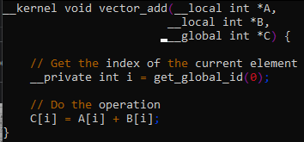
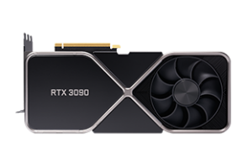
OpenCL Program
Firstly, creates a program object for a context, and loads source code specified by text strings into the program object.
cl_program clCreateProgramWithSource(
cl_context context, // a valid OpenCL context
cl_uint count, // number of source code
const char** strings, // array of source code pointers
const size_t* lengths, // array of source code lengths
cl_int* errcode_ret); // error codex
Secondly, compile the source code into binary.
cl_int clBuildProgram(
cl_program program, // a valid OpenCL program
cl_uint num_devices, // target device number
const cl_device_id* device_list, // target OpenCL devices
const char* options, // Supported compiler option flags
void (CL_CALLBACK* pfn_notify)(cl_program program, void* user_data), // Callback function
void* user_data); // The user_data field of callback function
A program can contain several source code and target multiple devices
clCreateProgramWithSource
Program Object
clBuildProgram
Program Binary

Slide 40
OpenCL Kernel
Firstly, a kernel is created as the single executable entity to the accelerating function, identified by the function name.
cl_kernel clCreateKernel(
cl_program program, // a valid OpenCL program
const char* kernel_name, // kernel function name
cl_int* errcode_ret); // error codex
Secondly, the arguments of the kernel function is set by index from leftmost, normally it’s pointing to an OpenCL memory buffer
cl_int clSetKernelArg(
cl_kernel kernel, // a valid OpenCL kernel
cl_uint arg_index, // index of kernel function argument
size_t arg_size, // size of the argument value
const void* arg_value); // argument value
Kernel object also targets different devices
kernel = clCreateKernel(program, " vector_add ", NULL);
clSetKernelArg(kernel, 0, sizeof(cl_mem), &bufferA);
clSetKernelArg(kernel, 1, sizeof(cl_mem), &bufferB);
clSetKernelArg(kernel, 2, sizeof(cl_mem), &bufferC);

Slide 41
Kernel Execution - function
Kernel is executed by equeuing a command on a device, including both data buffering and computational operations.
cl_int clEnqueueNDRangeKernel(
cl_command_queue command_queue, // a valid command queue
cl_kernel kernel, // a valid kernel
cl_uint work_dim, // global work group dimension
const size_t* global_work_offset, // global work item offset
const size_t* global_work_size, // global work item dimension range
const size_t* local_work_size, // local work item dimension range
cl_uint num_events_in_wait_list, // number of events
const cl_event* event_wait_list, // array of events before command executed
cl_event* event); // return event of kernel
Notice that this function does not guarantee all the commands in the queue are finished immediately. One could use cl_int clFlush(cl_command_queue command_queue); to force all the commands in the queue are executed.
Kernels are executed asynchronizedly.

Slide 42
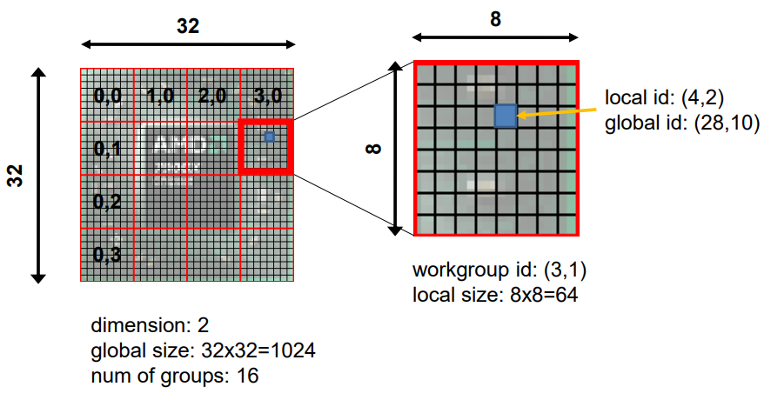
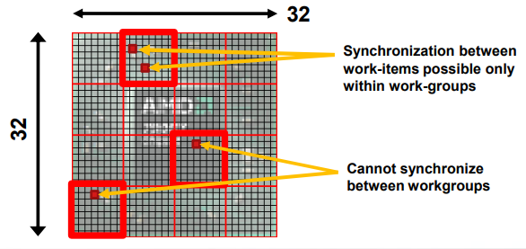
Kernel Execution – dimension
2D work group example:
cl_int clEnqueueNDRangeKernel(
command_queue, // a valid command queue
kernel, // a valid kernel
2, // work ground dimension
{0, 0}, // global work item offset
{32, 32}, // global work item dimension range
{8, 8}, // local work item dimension range
0, // number of events
NULL, // array of events
NULL); // return event of kernel
Synchronization only be possible within a workgroup

Slide 43
Release OpenCL Resources
At the end of the host program, delete the OpenCL objects using clReleaseXXX(…) and clean up the memory usages, e.g.:
… …
clReleaseKernel(kernel);
clReleaseProgram(program);
clReleaseCommandQueue(cmdQueue);
clReleaseMemObject(bufferA);
clReleaseMemObject(bufferB);
clReleaseMemObject(bufferC);
clReleaseContext(context);
… …

Slide 44
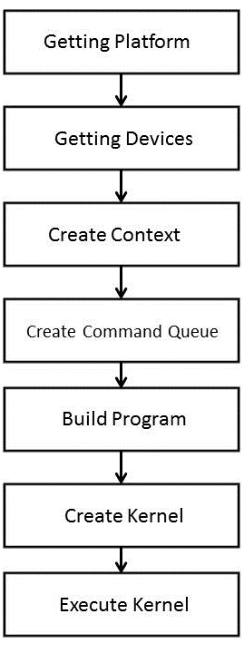
Host View of OpenCL Execution
Host setup:
STEP 1: Discover and initialize the platforms
STEP 2: Discover and initialize the devices
STEP 3: Create a context with one or more devices information
STEP 4: Create command queue to specific devices
Memory setup:
STEP 5: Create device buffers corresponding to kernel I/O
STEP 6: Write host data to device buffers
Kernel setup:
STEP 7: Create and compile the kernels program
STEP 8: Create the kernel with the kernel function name
STEP 9: Set the kernel arguments
STEP 10: Configure the work-item structure
STEP 11: Enqueue the kernel for execution
Memory setup:
STEP 12: Read the output buffer back to the host
Host setup:
STEP 13: Release OpenCL resources

Slide 45
Kernel Programming
C programming standard derived from ISO C99
Key features:
Preprocessing directives defined by C99 are supported ((#include, #if etc.)
__kernel qualifier declares a function as a kernel
Pointer kernel arguments must have an address space qualifier: __global, __local, __constant, __private
Supported built in functions:
Work item functions: get_global_id(), get_local_id(), get_global_size(), etc.
Synchronization functions:
barrier() - all work items within a work group must execute the barrier function before any work item can continue
mem_fence() - provides ordering between memory operations
math functions in math.h, read/write images, geometric functions and other extended functions, etc.
Key restrictions:
Pointers to functions are not allowed
Pointers to pointers allowed within a kernel, but not as an argument to a kernel invocation
Bit fields are not supported
Variable length arrays and structures are not supported
Recursion is not supported

Slide 46
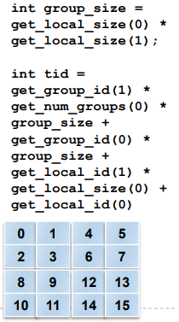
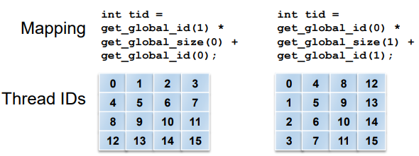
Kernel Execution – thread mapping
By using different mappings, the same thread can be assigned to access different data elements
The examples below show three different possible mappings of threads to data (assuming the thread id is used to access a single element) :
Column-wise
Row-wise
Block-wise
E.g.
Work_group_size = {32, 32};
get_global_size(0) = Work_group_size[0];
get_global_size(1) = Work_group_size[1];

Slide 47
Matrix Dot Product - Host
A = (int*)malloc(sizeof(int)*4*4);
B = (int*)malloc(sizeof(int)*4*4);
C = (int*)malloc(sizeof(int)*4*4);
… …
status = clEnqueueNDRangeKernel(
cmdQueue,
kernel,
2, // global work dimension
NULL,
{4, 4}, // global work item range
NULL,
0,
NULL,
NULL);
… …
Matrix data streaming
1
2
3
4
A
1
2
3
4
1
2
3
4
1
2
3
4
1
2
3
4
B
1
2
3
4
1
2
3
4
1
2
3
4
1
2
3
4
C
1
2
3
4
1
2
3
4
1
2
3
4
1
2
3
4
global work item index space

Slide 48
Matrix Dot Product - Device
__kernel void matrix_dot_mul(
const int RowSize,
const int ColSize,
const __global int *A,
const __global int *B,
__global int *C) {
// Indexing
const int col = get_global_id(0);
const int row = get_global_id(1);
const int wgdim1 = get_global_size(0);
const int wgdim2 = get_global_size(1);
// Computation
C[row*wgdim2+col] = A[row*wgdim2+col] * B[row*wgdim2+col];
}
1
2
3
4
1
2
3
4
1
2
3
4
1
2
3
4
1
2
3
4
1
2
3
4
1
2
3
4
1
2
3
4
1
2
3
4
1
2
3
4
1
2
3
4
1
2
3
4
1
2
3
4
i
=
i
x
i
i=row*wgdim2+col
1
1
2
3
4
2
1
2
3
4
row
3
1
2
3
4
4
1
2
3
4
col

Slide 49
Kernel View of OpenCL Execution
Input/output data stream setup
Step 1: input/output data pointer
Thread mapping
Step 2: get thread (work group) index (global or local)
Step 3: map computational operation by allocating index to input/output data
Parallel computation:
Step 4: compute on the indexed data
(optional) Step 5: synchronization within work group
Arguments
Get thread index
Map thread to data index
Thread computation

Slide 50
OpenCL Execution Summery
Arguments
Get thread index
OpenCL API @ host
Kernel @ host
Map thread to data index
Thread computation

Slide 51
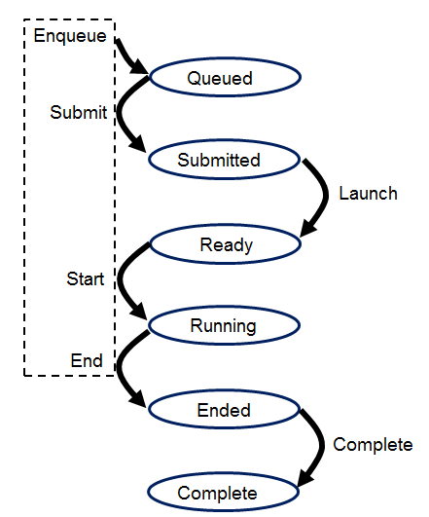
OpenCL Events
An event is an object that communicates the status of commands in OpenCL … legal values for an event:
CL_QUEUED: command has been enqueued.
CL_SUBMITED: command has been submitted to the compute device
CL_RUNNING: compute device is executing the command
CL_COMPLETE: command has completed
ERROR_CODE: a negative value, indicates an error condition occurred.
Every OpenCL event corresponds to an occurrence, and most of these occurrences involve commands and command queues.
In OpenCL we can use events in three main ways which are follows:
Host notification: An event can notify the host that a command has completed its execution on a device
Command synchronization: An event can force commands to delay their execution until another event's occurrence has taken place
Profiling: An event can monitor how much time a command takes to execute

Slide 52
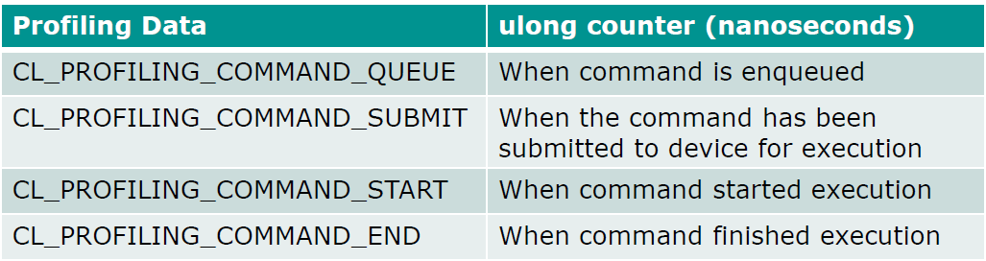
Events & Profiling
Enable profiling when creating queue with queue properties CL_QUEUE_PROFILING_ENABLE
Use clGetEvenProfilingInfo() to retrieve timing information
clGetEventProfilingInfo(
cl_event event, // the event object to get info for
cl_profiling_info param_name, // the profiling data to query -see list below
size_t param_value_size, // the size of memory pointed by param_value
void* param_value, // pointer to memory in which the query result is returned
size_t* param_actual_size ); // actual number of bytes copied to param_value

Slide 53
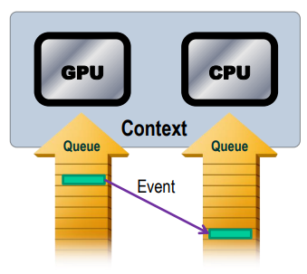
Insert Profiling Event
… …
cl_event user_event = clCreateUserEvent(context, &status); // create event object
cl_event kernel_event; // create kernel event container
status = clEnqueueNDRangeKernel( // implant event into kernel enqueue function
cmdQueue,
kernel,
gloablWorkDim,
NULL,
globalWorkSize,
NULL,
1, // number of event
user_event, // event object
kernel_event); // returned event
… …
Insert event

Slide 54
Matrix Dot Product
… …
clSetUserEventStatus(user_event, CL_COMPLETE);
clWaitForEvents(1, &kernel_event);
cl_ulong time_start, time_end;
clGetEventProfilingInfo(
kernel_event,
CL_PROFILING_COMMAND_START,
sizeof(time_start),
&time_start,
NULL);
clGetEventProfilingInfo(kernel_event,
CL_PROFILING_COMMAND_END,
sizeof(time_end), &time_end, NULL);
… …
double nanoSeconds = time_end-time_start;
printf("Total Kernel Execution time is: %0.3f milliseconds \n", nanoSeconds / 1000000.0);
… …

Slide 55
Synchronization
All work-items in a work-group executing the kernel on a processor must execute barrier() function before any are allowed to continue execution beyond it
void barrier(cl_mem_fence_flags flags)
cl_mem_fence_flags:
CLK_LOCAL_MEM_FENCE - The barrier function will ensure that all local memory accesses become visible to all work items in the work-group.
CLK_GLOBAL_MEM_FENCE – The barrier function ensure that all global memory accesses become visible to the appropriate scope as given by scope.
CLK_IMAGE_MEM_FENCE – The barrier function will ensure that all image memory accesses become visible.

Slide 56

Flying Like Superhero

Slide 57
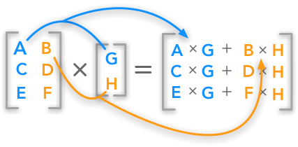
OpenCL Optimization
Maximize parallel execution
Exposing data parallelism in algorithms
Choosing execution configuration
Overlap memory transfer with computation
Maximize memory bandwidth
Keep the hardware busy
Maximize instruction throughput
Get the job done with as few clock cycles as possible
Matrix Multiplication

Slide 58
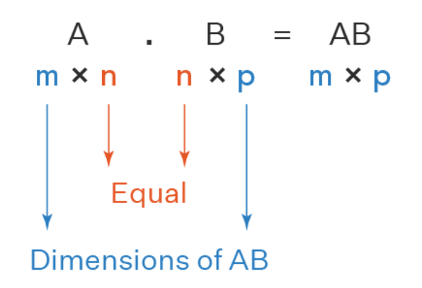
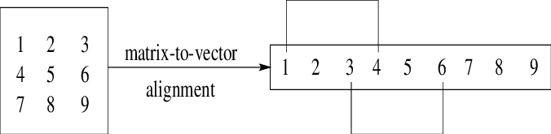
Matrix Multiplication - Sequential
Sequential code:
#define DIM1 4096 // row of A, row of C
#define DIM2 1024 // col of A, row of B
#define DIM3 256 // col of B, col of C
… …
int *A = (int *) malloc(sizeof(int)*DIM1*DIM2);
int *B = (int *) malloc(sizeof(int)*DIM2*DIM3);
int *C = (int *) malloc(sizeof(int)*DIM1*DIM3);
… …
for(i=0;i<DIM1;i++){
for(k=0;k<DIM3;k++){
C[i*DIM3+k] = 0;
for(j=0;j<DIM2;j++){
C[i*DIM3+k] += A[i*DIM2+j] * B[j*DIM3+k];
}
}
}
… …
Matrices are stored as row major order in C memory layout
data parallelism !!!

Slide 59
Matrix Multiplication - OpenCL Kernel
__kernel void matmul(const int M,
const int N,
const int K,
const __global int *A,
const __global int *B,
__global int *C) {
// Thread identifiers
const int globalRow = get_global_id(0); // Row ID of C (0..M)
const int globalCol = get_global_id(1); // Col ID of C (0..K)
// Compute a single element (loop over N)
int acc = 0;
for (int n=0; n<N; n++) {
acc += A[globalRow*N + n] * B[globalCol + n*K];
}
// Store the result
C[globalRow*K + globalCol] = acc;
}
K
N
M

Slide 60
Uncoalesced Memory Access
K
Remember: matrices are stored as row major order in C memory layout, so the vectorized memory copy from main memory to GPU memory follows the same layout.
Assume:
the memory bus is 32 bytes (256-bits) wide (This is the data width on a Radeon 5870 GPU)
the matrix element is integer (int, 4 bytes, 32 bits)
The column major ordered access will waste the bandwidth since every 32 bytes memory copy has only 4 bytes useful data.
In another word, it must copy entire matrix each time to do a computation for a single thread.
N
cl_mem
… …
Bus
bandwidth

Slide 61
Coalesced memory access
K
Transpose matrix B to row major ordered as matrix A in main memory.
… …
for(i=0; i<DIM2; i++){
for(j=0; j<DIM3; j++){
Bt[j*DIM2+i] = B[i*DIM3+j];
}
}
… …
The column of vectorized matrix B will have consecutive elements for computation.
Every memory copy from main memory to GPU memory contains all the elements for computation.
In another word, only a column of matrix B is required for each computational work item.
N

Slide 62
Matrix Multiplication – Execution Configuration
Configure the global work size as the output matrix dimension, hence each thread compute a single output matrix elements:
… …
int M = DIM1, N = DIM2, K = DIM3;
… …
int gloablWorkDim = 2;
size_t globalWorkSize[2] = {M, K};
status = clEnqueueNDRangeKernel(
cmdQueue,
kernel,
gloablWorkDim,
NULL,
globalWorkSize,
NULL,
1,
/*NULL*/&user_event,
/*NULL*/&kernel_event);
… …
K
M

Slide 63
Pipeline Memory Access & Kernel Computation
Interleave the command of memory copy, between main memory and GPU memory, and kernel execution.
This is very important for data streaming.
The ideal case would be balanced memory access and kernel execution time, so either kernel don’t need to wait for data coming or don’t need to buffer data for kernel execution
Might be better than
Or not …
CL Memory Write
Kernel Execution
CL Memory Write
CL Memory Write
Kernel Execution
CL Memory Read
CL Memory Write
CL Memory Write
CL Memory Write
CL Memory Read
CL Memory Write
CL Memory Write
Kernel Execution
Kernel Execution
CL Memory Write
Kernel Execution
CL Memory Write
CL Memory Read
CL Memory Write
CL Memory Read
CL Memory Write
CL Memory Read
CL Memory Read
Kernel Execution

Slide 64
Code Therapy
Step 1: transpose matrix B to row major ordered
Step 2: create standard OpenCL objects
Step 3: configure the global work size
Step 4: create OpenCL memory access and kernel execution command, and enqueue them in interleaving.
Step 5: compare the run time between coalesced (transposed matrix order) and uncoalesced (native matrix order) kernel execution

Slide 65

Can it be better ?
Remember that the local memory is about 10x times faster than using global memory in the memory model
By tiling in local memory, we divide the global work size into subblocks local work size
… …
int gloablWorkDim = 2;
int TileSize = 32;
size_t localWorkSize[2] = {TileSize, TileSize};
size_t globalWorkSize[2] = {M, K};
status = clEnqueueNDRangeKernel(
cmdQueue,
kernel,
gloablWorkDim,
NULL,
globalWorkSize,
localWorkSize,
1,
/*NULL*/&user_event,
/*NULL*/&kernel_event);
… …

Slide 66
Code Therapy
Step 1: transpose matrix B to row major ordered
Step 2: create standard OpenCL objects
Step 3: configure the global work size and local work size
Step 4: adjust the kernel operations to use local memory synchronously
Step 5: create OpenCL memory access and kernel execution command, and enqueue them in interleaving.
Step 6: compare the run time between tiling kernel and untiling kernel execution

Slide 67

Sublimation … …

Slide 68

Still Not Good Enough ?
By increasing the amount of work in each thread or wrapping multiple tiling blocks into one (and thus reducing the total number of threads), this will reduce amount of local memory accesses.
This will increase arithmetic instruction ratio which is better in “GFLOPS”.
… …
int gloablWorkDim = 2;
int TileSize = 32;
int WrappedTiles = 4;
size_t localWorkSize[2] = {TileSize, TileSize/ WrappedTiles};
size_t globalWorkSize[2] = {M, K/WrappedTiles};
status = clEnqueueNDRangeKernel(
cmdQueue,
kernel,
gloablWorkDim,
NULL,
globalWorkSize,
localWorkSize,
1,
/*NULL*/&user_event,
/*NULL*/&kernel_event);
… …

Slide 69
Code Therapy
Step 1: transpose matrix B to row major ordered
Step 2: create standard OpenCL objects
Step 3: configure the global work size and local work size
Step 4: adjust the kernel operations to use local memory synchronously and wrap local memory operations
Step 5: create OpenCL memory access and kernel execution command, and enqueue them in interleaving.
Step 6: compare the run time between wrapping kernel and unwrapping kernel execution

Slide 70
Further Optimization…
How to choose optimal global/local work size …
How to choose optimal tiling dimension …
How to choose optimal wrapping factor …
Can we further utilize fastest register (private memory) …
Can we use vectorized data type to further improve the bandwidth utilization …
Why using CUDA on Nvidia GPGPU not OpenCL …
… …
It’s heterogeneous systems …
It depends on devices’ features …
But those optimizing methods generally work well …

Slide 71


Why not OpenCL Hardware
Instead of using OpenCL to fit each parallel “black box” architecture, one could translate OpenCL into real hardware architecture.
OpenCL hardware:
Accelerating DNNs with Xilinx Alveo Accelerator Cards
Accelerating Deep Learning with the OpenCL™ Platform and Intel® Stratix® 10 FPGAs
Further reading:
From OpenCL to High-Performance Hardware on FPGAs, Tomasz S. Czajkowski, etc., 22nd International Conference on Field Programmable Logic and Applications (FPL), 2012.
Optimizing OpenCL Code for Performance on FPGA, Nuno Paulino, etc., IEEE Access, 2020.

Slide 72

See you in MPI

